Slide 1
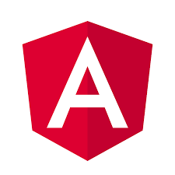
Angular
Developing SPA with Angular 12
DATE
30th June 2021

Slide 2

NgRx is a framework for building reactive applications in Angular.
NgRx provides libraries for:
Managing global and local state.
Entity collection management.
Integration with the Angular Router.
Developer tooling that enhances developer experience when building many different types of applications.

Slide 3
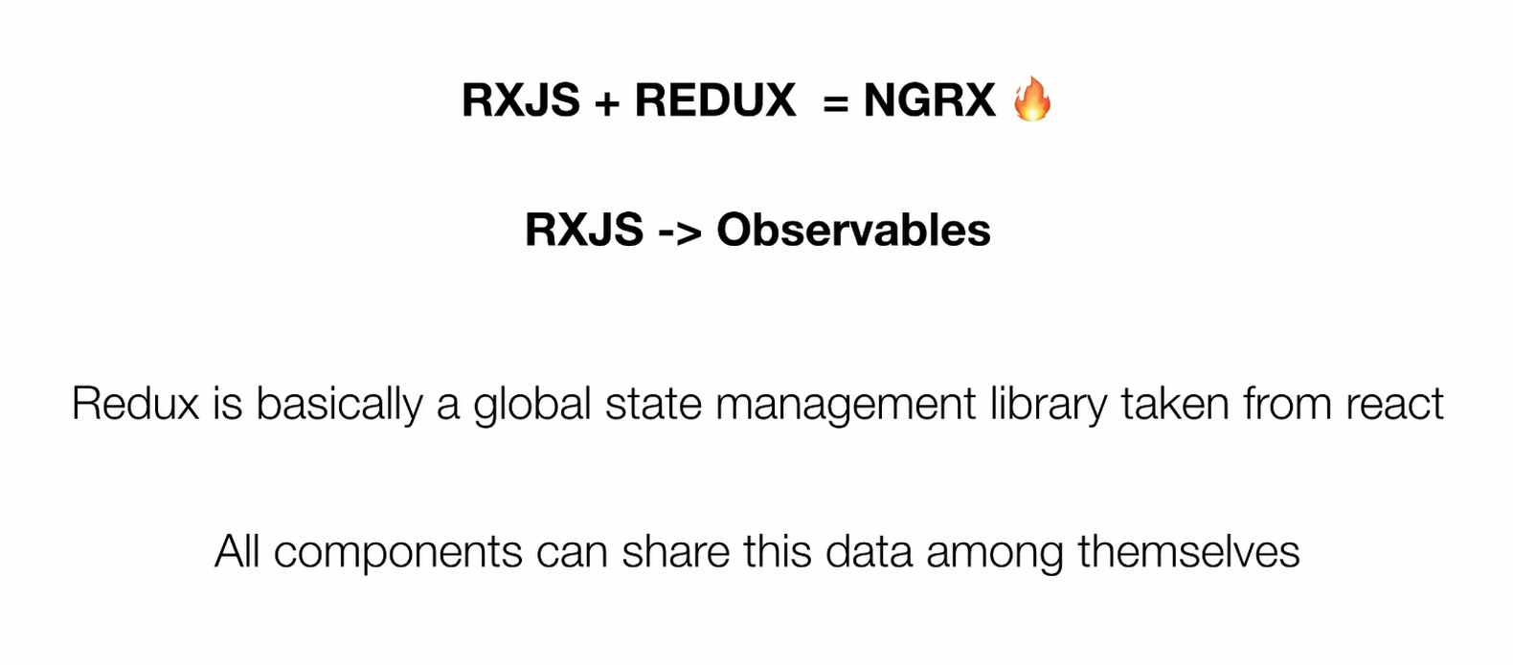

Slide 4
Actions describe unique events that are dispatched from components and services.
State changes are handled by pure functions called reducers that take the current state and the latest action to compute a new state.
Selectors are pure functions used to select, derive and compose pieces of state.
State is accessed with the Store, an observable of state and an observer of actions.

Slide 5
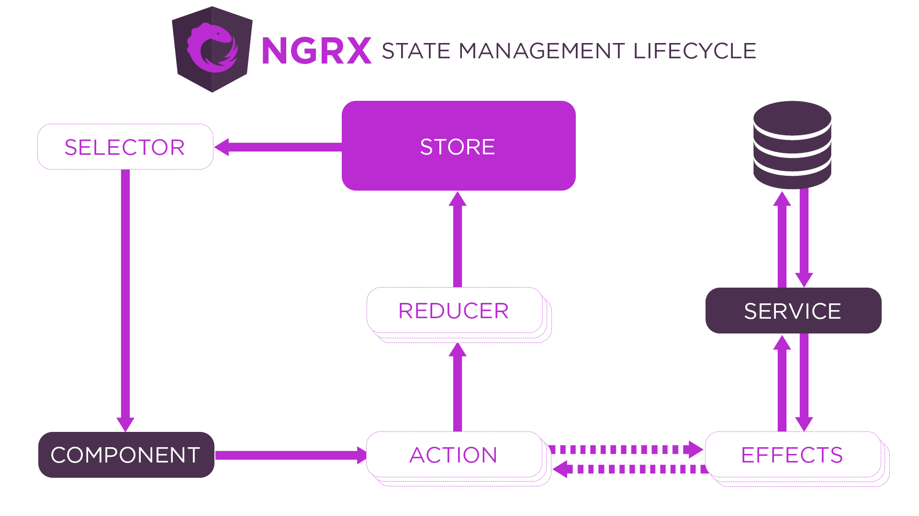

Slide 6
The state is never changed directly. Instead, the reducer always creates a new state. This is known as immutability

Slide 7
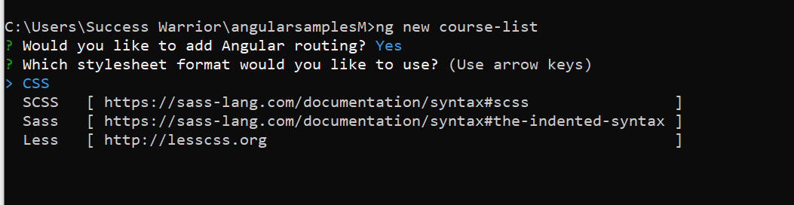

Slide 8
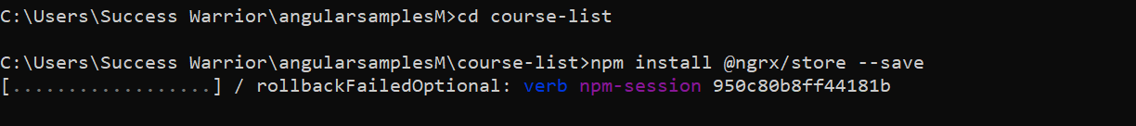
npm install @ngrx/store --save

Slide 9
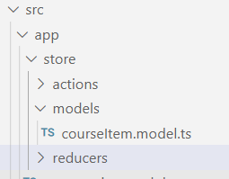
Create store directory with following three directories in it

Slide 10
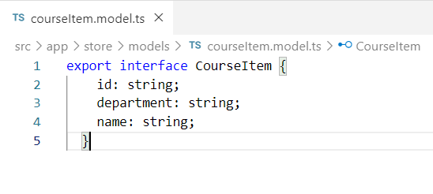

Slide 11
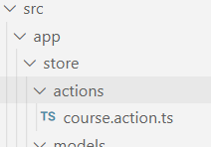
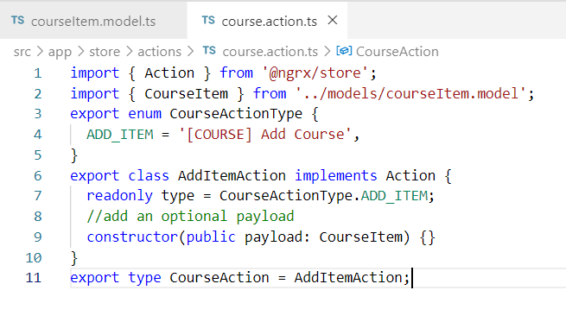

Slide 12
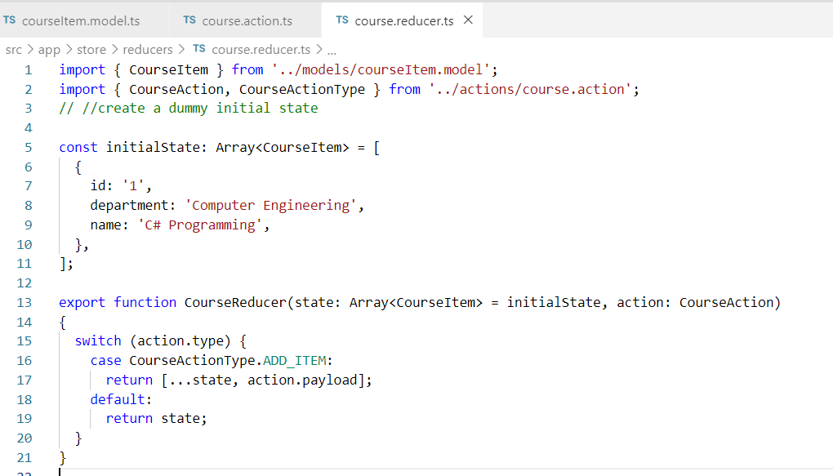
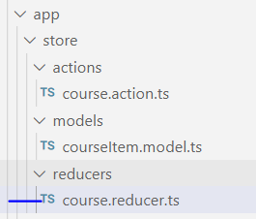
We use the JavaScript statement to check if the action type is defined in our actions file. If it does exist, it returns the state and the action payload. If not, it just returns the state.

Slide 13
NgRx will keep all application state in a single store so that it can be assessable from any part of the application

Slide 14
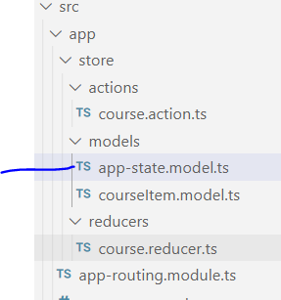
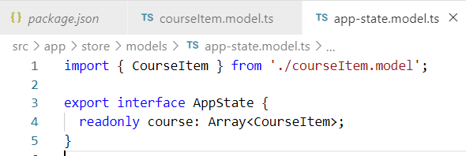

Slide 15
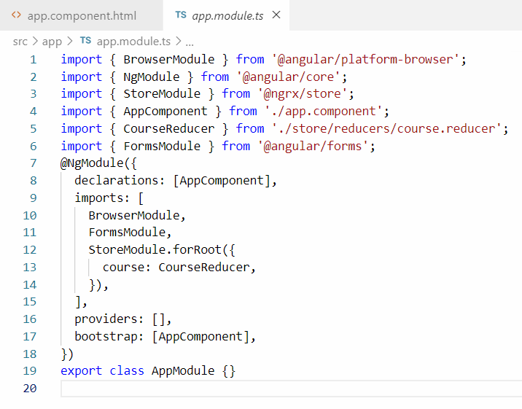

Slide 16
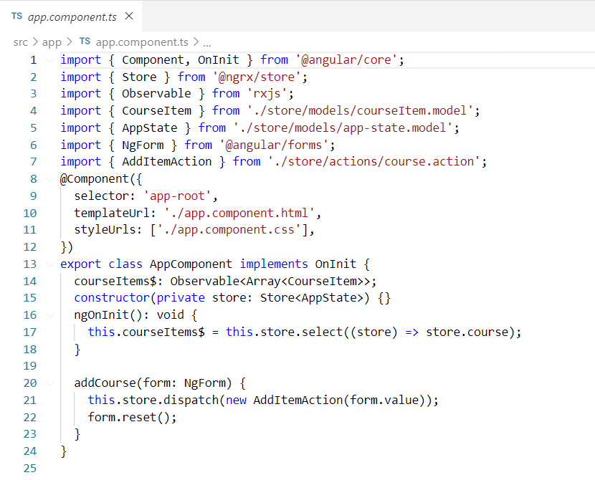

Slide 17
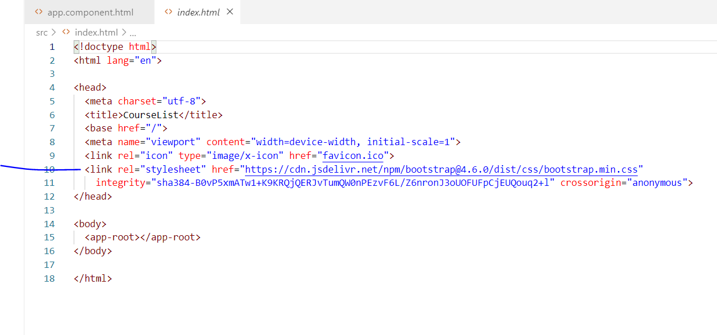

Slide 18
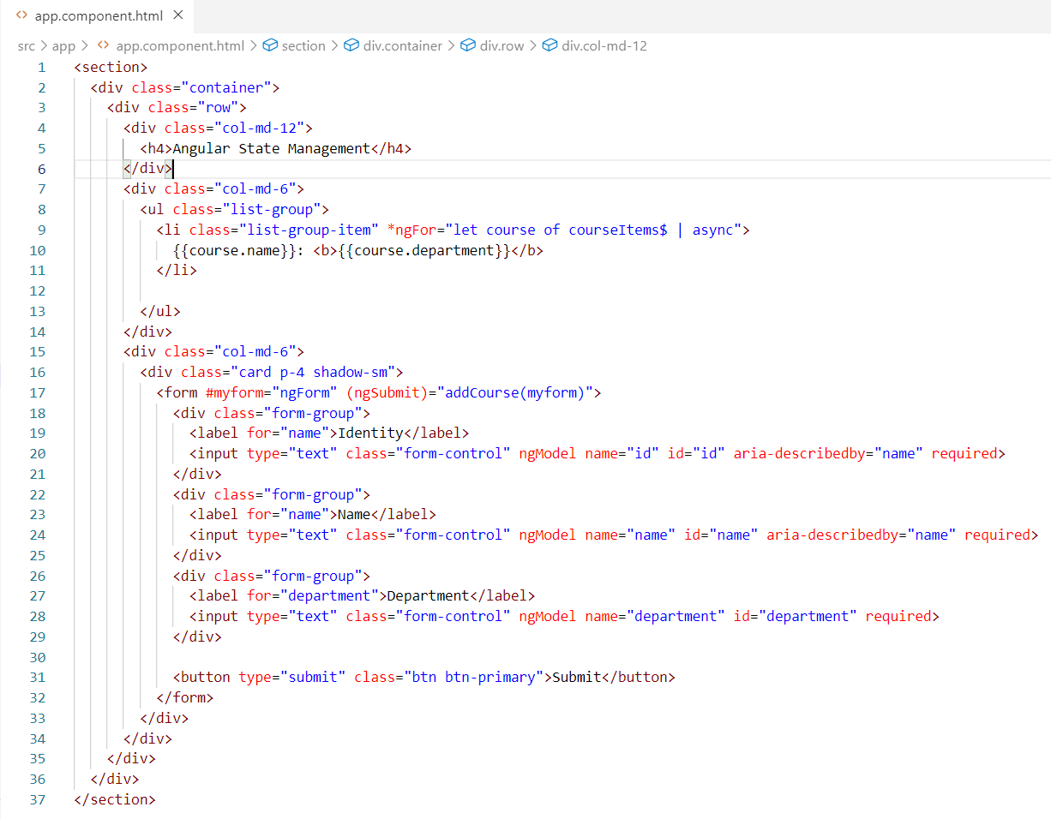

Slide 19
